Slide 1

Deep Learning
Prof. Gajanan Wankhade

Slide 2
Unit-II Deep Learning Models
Introduction to CNNs
A Convolutional Neural Network (CNN) is a class of deep learning models primarily used for processing grid-like data such as images. CNNs automatically learn spatial hierarchies of features using convolution operations, making them highly effective for computer vision tasks.
Key Characteristics of CNNs
Local connectivity
Parameter sharing
Translation invariance
Fewer parameters compared to fully connected networks

Slide 3
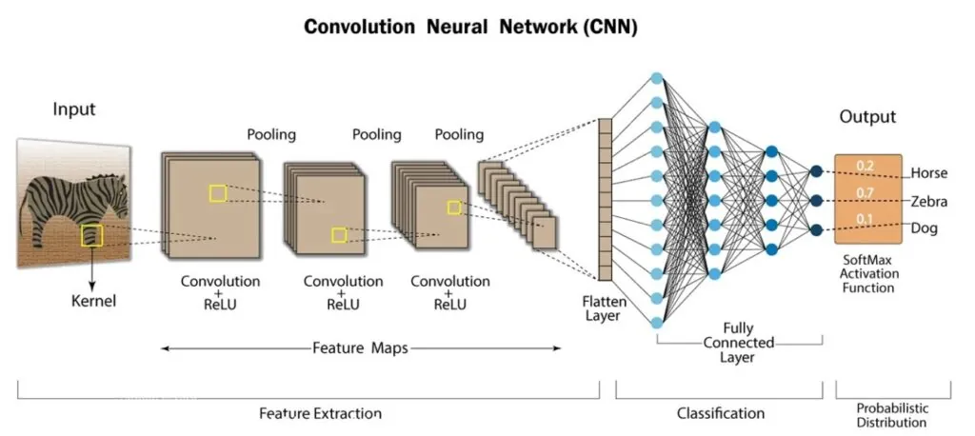
Convolutional Neural Network (CNN)

Slide 4
Convolutional Neural Network (CNN) Layers
Convolutional Layers:
Pooling Layers:
Activation Functions:
Fully Connected Layers:

Slide 5
How to Evaluate CNN Models
Accuracy: Accuracy is the percentage of test images that the CNN correctly classifies.
Precision: Precision is the percentage of test images that the CNN predicts as a particular class and that are actually of that class.
Recall: Recall is the percentage of test images that are of a particular class and that the CNN predicts as that class.
F1 Score: The F1 Score is a harmonic mean of precision and recall. It is a good metric for evaluating the performance of a CNN on classes that are imbalanced.

